Slide 1
Distributed Coordination-Based
Systems

Slide 2
Coordination models
Essence
We are trying to separate computation from coordination; coordination deals with all aspects of communication between processes, as well as their cooperation.
Couplings
Make a distinction between
Temporal coupling: Are cooperating/communicating processes alive at the same time?
Referential coupling: Do cooperating/communicating processes know each other explicitly?

Slide 3
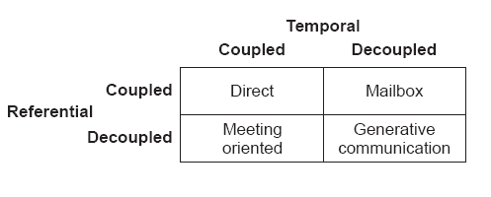
Coordination models

Slide 4
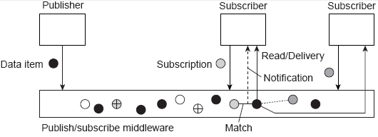
Architectures: Overview
Essence
A data item is described by means of attributes.
When made available, it is said to be published.
A process interested in reading an item, must provide a subscription: a description of the items it wants.
Middleware must match published items and subscriptions.

Slide 5
Example: Jini/Javaspaces
Coordination model
Temporal and referential uncoupling by means of JavaSpaces, a tuple-based storage system.
A tuple is a typed set of references to objects
Tuples are stored in serialized, that is, marshaled form into a JavaSpace
To read a tuple, construct a template, with some fields left open
Match a template against a tuple through a field-by-field comparison

Slide 6
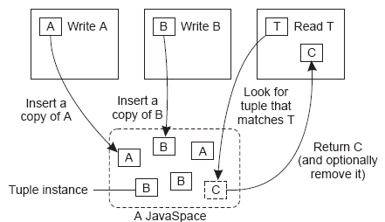
Example: Jini/Javaspaces
Write: A copy of a tuple (tuple instance) is stored in a JavaSpace
Read: A template is compared to tuple instances; the first match returns a tuple instance
Take: A template is compared to tuple instances; the first match returns a tuple instance and removes the matching instance from the JavaSpace

Slide 7
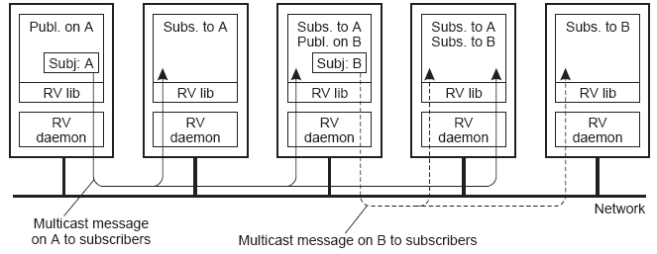
Example: TIB/Rendezvous
Coordination model
Uses of subject-based addressing publish-subscribe system.
Receiving a message on subject X is possible only if the receiver had subscribed to X
Publishing a message on subject X message is sent to all (currently running) subscribers to X.

Slide 8
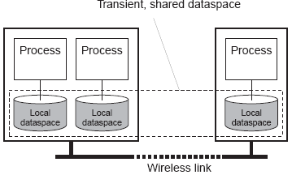
Example: Lime
Lime
Every node has its own dataspace:
When P and Q are in each other’s proximity, dataspaces become shared
Published data items are stored locally, until removed
P can publish data items from specific process
Reactions describe what to do when a match is found

Slide 9
Content-based routing
Observation
When a coordination-based system is built across a wide-area network, we need an efficient routing mechanism (centralized solutions won’t do).
Solution
Naive: Broadcast subscriptions to all nodes in the system and let servers prepend destination address when data item is published
Refinement: Forward subscriptions to all routers and let them compute and install filters.

Slide 10
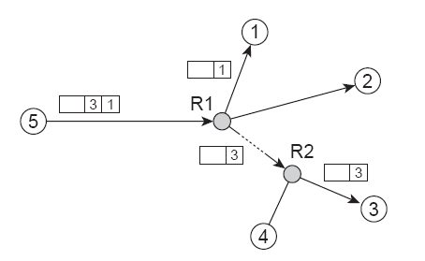
Content-based routing: naive solution

Slide 11
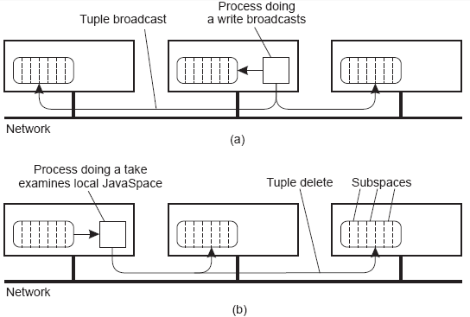
Replication: Static approaches
Note
Replicating data items to all machines implies broadcasting removals.

Slide 12
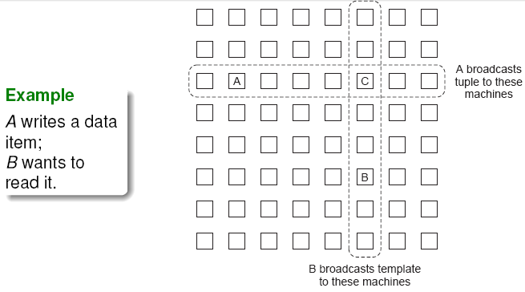
Balancing read/write operations
Problem
Find a balance between the costs for reads, and writes/removals organize dataspace as 2D grid

Slide 13
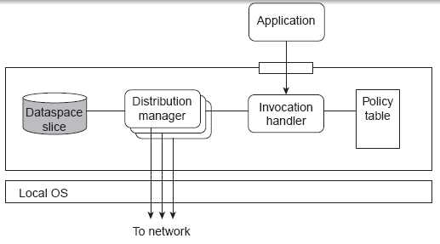
Dynamic replication
Observation: Not all data items are equal
Decide on replication on a per-type basis
Refinement: Let a central component observe read/write patterns and decide on replication strategy (self-replication) service.

Slide 14

Fault tolerance
Observation
In many cases, fault tolerance is achieved by using a primary-backup approach for a central dataspace server.
Refinement
Decide per data type the required availability, and replicate based on availability of nodes:
  MTTF: mean time to failure
  MTTR: mean time to repair
  Node availability:
Let nodes estimate MTTF and MTTR by logging the current time.

Slide 15
Security
Dilemma
We wanted anonymity between processes, but security requires that we authenticate publishers and subscribers we need to trust the servers that establish the matching between the two.
  Information confidentiality: the middleware is not allowed to see what data is published. In practice, only restricted number of fields can be used.
  Subscription confidentiality: the middleware is not allowed to see what subscriptions look like. Solution: Match on encrypted data fields, although this alone will often reveal too much info on publishers and subscribers.
  Publication confidentiality: ensure that specific processes are not even allowed to see certain messages.

Slide 16
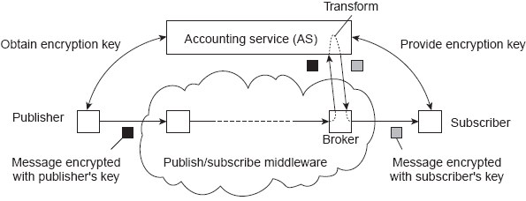
Secure decoupling
Solution
Let an accounting service manage keys, and re-encrypt a data item before it is forwarded to a subscriber (1) routers work on encrypted data, (2) publisher and subscriber need not share a key.
Dilemma
Is security the show-stopper for publish/subscribe systems?

